Slide 1
GROUP 3 MAE ASSIGNMENT 6 FUNCTIONS IN MATLAB
GROUP MEMBERS | REGISTRATION NUMBERS
NAKAKANDE RACHEAL | BU/UP/2025/05767
LYAKA AMELIA KIRABO | BU/UP/2025/05765
DRICHI HANNINGTON HENRY | BU/UP/2025/4963
SSENYONJO TREVOR | BU/UP/2025/05769
ATWANZIRE VICTOR | BU/UP/2025/5176

Slide 2
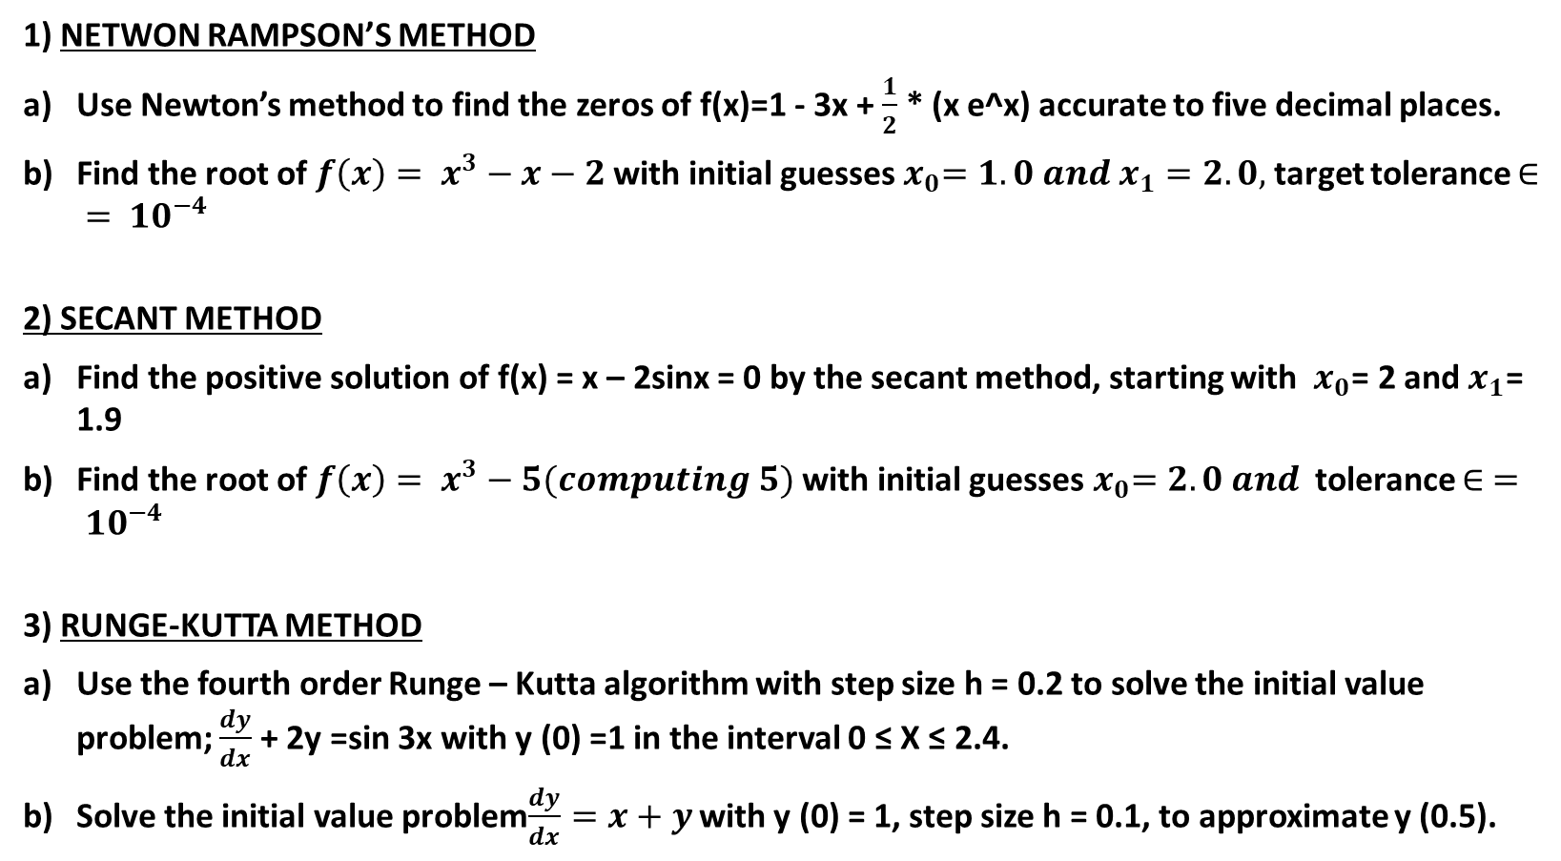
1) NETWON RAMPSON’S METHOD
Use Newton’s method to find the zeros of f(x)=1 - 3x + $\frac{1}{2}$ * (x e^x) accurate to five decimal places.
Find the root of $f\left(x\right)= x^{3}−x−2$ with initial guesses${ x}_{0}=1.0 and x_{1}=2.0,$target tolerance $∈ = {10}^{−4}$
2) SECANT METHOD
Find the positive solution of f(x) = x – 2sinx = 0 by the secant method, starting with $x_{0}$= 2 and $x_{1}$= 1.9
Find the root of $f\left(x\right)= x^{3}−5(computing 5)$ with initial guesses${ x}_{0}=2.0 and$ tolerance $∈ = {10}^{−4}$
3) RUNGE-KUTTA METHOD
Use the fourth order Runge – Kutta algorithm with step size h = 0.2 to solve the initial value problem; $\frac{dy}{dx}$ + 2y =sin 3x with y (0) =1 in the interval 0 ≤ X ≤ 2.4.
Solve the initial value problem$\frac{dy}{dx}=x+y$ with y (0) = 1, step size h = 0.1, to approximate y (0.5).

Slide 3
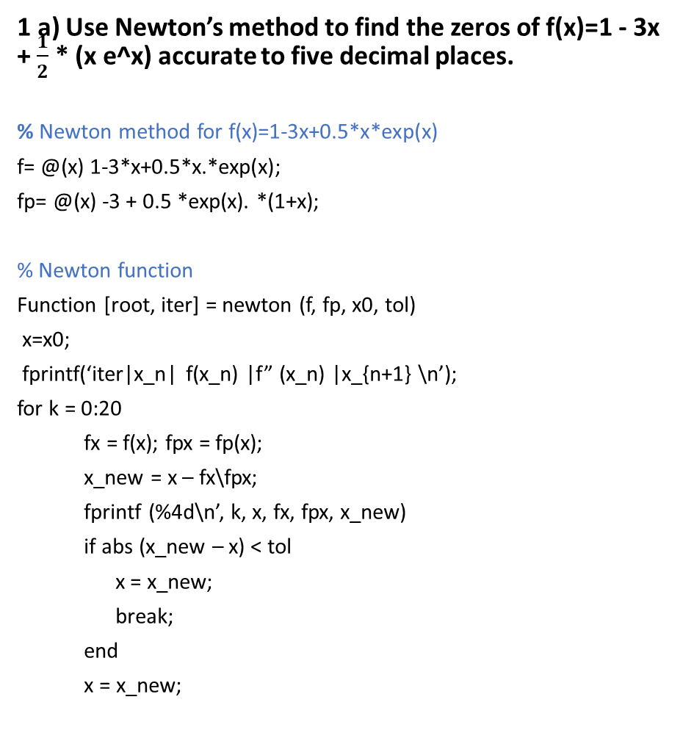
1 a) Use Newton’s method to find the zeros of f(x)=1 - 3x + $\frac{1}{2}$ * (x e^x) accurate to five decimal places.
% Newton method for f(x)=1-3x+0.5*x*exp(x)
f= @(x) 1-3*x+0.5*x.*exp(x);
fp= @(x) -3 + 0.5 *exp(x). *(1+x);
% Newton function
Function [root, iter] = newton (f, fp, x0, tol)
x=x0;
fprintf(‘iter|x_n| f(x_n) |f” (x_n) |x_{n+1} \n’);
for k = 0:20
fx = f(x); fpx = fp(x);
x_new = x – fx\fpx;
fprintf (%4d\n’, k, x, fx, fpx, x_new)
if abs (x_new – x) < tol
x = x_new;
break;
end
x = x_new;
end
root = x;
iter = k + 1;
end
tol = 1e-8; % for 5 decimal places
% Root 1 – start at 0.4
fprintf (‘\n===ROOT 1 guess x0 = 0.4 ===\n’)
[r1, ~] = newton (f, fp, 0.4, tol);
fprintf (‘Root1 = %.10f -> 5 dec = %. 5f\n’, r1, r1);
% Root 2 – start at 1.2
fprintf (‘\n===ROOT 2 guess x0 = 1.2 ===\n’)
[r2, ~] = newton (f, fp, 1.2, tol);
fprintf (‘Root2 = %.10f -> 5 dec = %. 5f\n’, r2, r2);

Slide 4
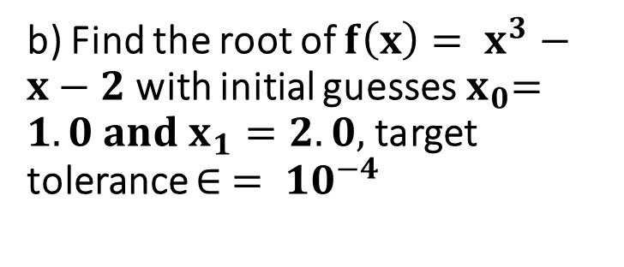
b) Find the root of $f\left(x\right)= x^{3}−x−2$ with initial guesses${ x}_{0}=1.0 and x_{1}=2.0,$target tolerance $∈ = {10}^{−4}$
x_new = x - fx/fpx;
err = abs (x_new - x);
fprintf ('%2d %12.10f %10.6f %10.6f %12.10f %12.8f\n', n, x, fx, fpx, x_new, err);
if err < tol
x = x_new;
break;
end
x = x_new;
end
fprintf ('\nRoot = %.10f\n', x);
fprintf ('Root 5dp = %.5f\n', x);
fprintf ('f(root) = %e\n', f(x));
clc; clear;
f = @(x) x.^3 - x - 2;
fp = @(x) 3*x.^2 - 1;
x0 = 2.0; % initial guess
tol = 1e-4; max_iter = 20; x = x0;
fprintf (' n x_n f(x_n) f''(x_n) x_{n+1} |x_{n+1}-x_n|\n');
for n = 0:max_iter
fx = f(x);
fpx = fp(x);
if fpx == 0
error ('Derivative zero');
end

Slide 5
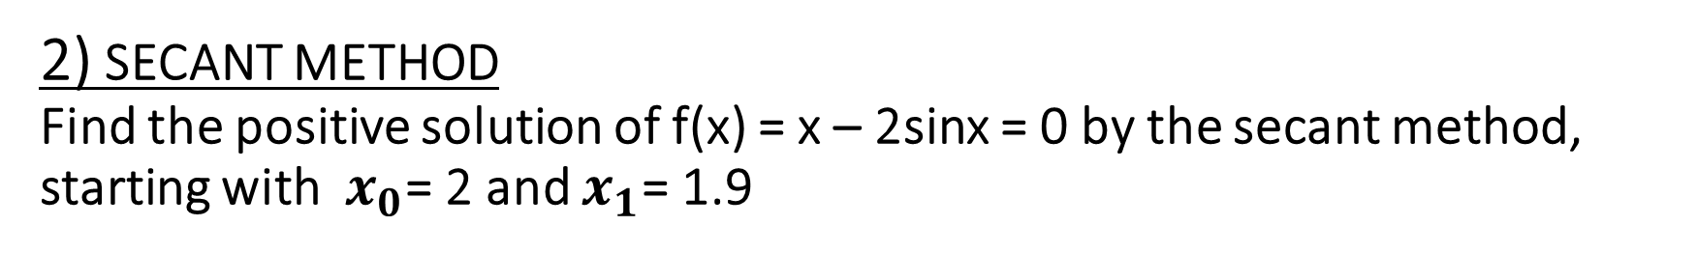
2) SECANT METHOD
Find the positive solution of f(x) = x – 2sinx = 0 by the secant method, starting with $x_{0}$= 2 and $x_{1}$= 1.9
x0 = 2;
x1 = 1.9;
tol =1e-6;
max_iter = 20;
fprintf (‘n, x0, x1, f(x0), f(x1), x2\n’);
for n = 0:max_iter
fx0 = f(x0); fx1 = f(x1);
% Secant formula
x2 = x1 - fx1*(x1 - x0) / (fx1 - fx0);
fprintf ('%2d %10.8f %10.8f %10.8f %10.8f %12.10f\n', n, x0, x1, fx0, fx1, x2);
if abs (x2 - x1) < tol
break;
end
% next iteration
x0 = x1; x1 = x2;
end
fprintf ('\nPositive root = %.10f\n', x2);
fprintf ('Positive root 5dp = %.5f\n', x2);
fprintf('f(root) = %e\n', f(x2));

Slide 6
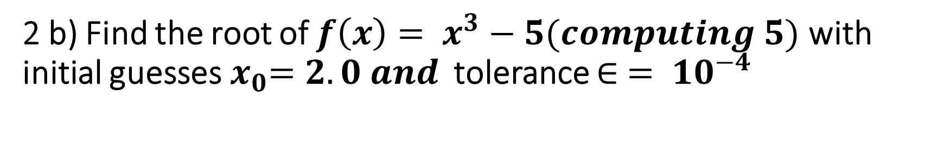
2 b) Find the root of $f\left(x\right)= x^{3}−5(computing 5)$ with initial guesses${ x}_{0}=2.0 and$ tolerance $∈ = {10}^{−4}$
f = @(x) x.^3 - 5;
x0 = 1.0; % initial guess
x1 = 2.0;
tol = 1e-4;
fprintf (' n x_{n-1} x_n f(x_{n-1}) f(x_n) x_{n+1} |x_{n+1}-x_n|\n')
for n=0:20
fx0 = f(x0);
fx1 = f(x1);
x2 = x1 - fx1*(x1-x0)/(fx1-fx0);
err = abs(x2-x1);
fprintf ('%2d %10.8f %10.8f %10.6f %10.6f %12.10f %10.8f\n’, n, x0, x1, fx0, fx1, x2, err);
if err < tol
break;
end
x0 = x1;
x1 = x2;
end
fprintf ('\nCube root of 5 = %.10f\n', x2);
fprintf ('5dp = %.5f\n', x2);
fprintf('f(root) = %e\n', f(x2));

Slide 7
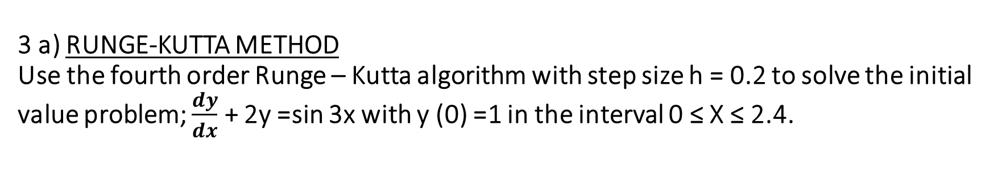
3 a) RUNGE-KUTTA METHOD
Use the fourth order Runge – Kutta algorithm with step size h = 0.2 to solve the initial value problem; $\frac{dy}{dx}$ + 2y =sin 3x with y (0) =1 in the interval 0 ≤ X ≤ 2.4.
fprintf (‘%2d %4.1f %8.6f %8.5f %8.5f %8.5f %8.5f %10.6f\n’, ...
n-1, xn, y_n, k1, k2, k3, k4, y(n+1));
end
% Display table
fprintf ('\nFinal Solution:\n');
fprintf (' x y\n');
for i=1: length(x)
fprintf ('%5.1f %10.6f\n', x(i), y(i));
end
% Plot
plot (x, y,'-o');
xlabel('x');
ylabel('y');
title ('RK4: dy/dx + 2y = sin3x, y (0) = 1, h = 0.2');
grid on;
clc; clear;
% f (x, y) = sin(3x) - 2y
f = @ (x, y) sin(3*x) - 2*y;
h = 0.2; % step size
x = 0:h:2.4;
y = zeros(size(x));
y (1) = 1; y (0) =1
fprintf (' n x_n y_n k1 k2 k3 k4 y_{n+1}\n');
for n = 1: length(x)-1
xn = x(n); y_n = y(n);
k1 = f (xn, y_n);
k2 = f (xn + h/2, y_n + h*k1/2);
k3 = f (xn + h/2, y_n + h*k2/2);
k4 = f (xn + h, y_n + h*k3);
y(n+1) = y_n + h/6*(k1 + 2*k2 + 2*k3 + k4);

Slide 8
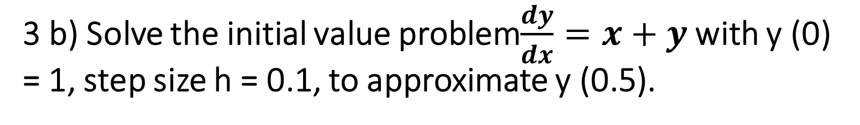
3 b) Solve the initial value problem$\frac{dy}{dx}=x+y$ with y (0) = 1, step size h = 0.1, to approximate y (0.5).
clc; clear;
f = @ (x, y) x + y;
h = 0.1; x = 0:h:0.5;
y = zeros(size(x));
y (1) = 1; % y (0) =1
fprintf (' n x_n y_n k1 k2 k3 k4 y_{n+1} \n');
for n = 1: length(x)-1
xn = x(n); yn = y(n);
k1 = f (xn, yn);
k2 = f (xn + h/2, yn + h*k1/2);
k3 = f (xn + h/2, yn + h*k2/2);
k4 = f (xn + h, yn + h*k3);
y(n+1) = yn + h/6*(k1 + 2*k2 + 2*k3 + k4);
fprintf ('%2d %4.1f %8.6f %7.4f %7.4f %7.4f %7.4f %8.6f\n', ...
n-1, xn, yn, k1, k2, k3, k4, y(n+1));
end
% Plot
plot (x, y,'-o'); grid on;
xlabel('x'); ylabel('y');
title ('RK4 dy/dx=x+y, y (0) =1, h=0.1');
% Exact solution: y = 2e^x - x - 1
y_exact = 2*exp(x) - x - 1;
fprintf ('\nAt x=0.5, RK4 y=%.10f, Exact y=%.10f, Error=%.2e\n', y(end), y_exact(end), abs(y(end)-y_exact(end)));

